Slide 1
Databases & Firebase
Presented by Kelvin Gonzalez

Slide 2
Lecture Menu
What are Databases
SQL (Supabase) vs NoSQL (Firebase)
Firebase Setup
Firebase Structure
Basic Firebase Requests
Using Real-time Data
Handling Conflicting Requests

Slide 3
What are Databases?
A database is where all records for an application are usually stored
It is contained in some external computer or cloud that you communicate to via API requests
Databases are used when application data is either too large to be contained within the device (whether memory or storage) or when an application requires multiple devices to have their data synchronized

Slide 4
SQL vs NoSQL
SQL is a language used to easily query data from a database via a multitude of powerful methods
Filtering by specific fields, joining table data, creating subqueries, etc.
SQL requires your data to be structured via tables that follow a specific schema
Supabase uses a SQL database
Free tier allows 50k monthly users and unlimited API requests
NoSQL databases are those that do not make use of SQL and so miss out on the capabilities of the SQL language
NoSQL databases function like JSON files where data does not follow a specific schema, although you can nest objects and lists unlike in SQL
Firebase uses a NoSQL database
Free tier only allows 50k reads, 20k writes, and 10k deletes per day, but unlimited users

Slide 5
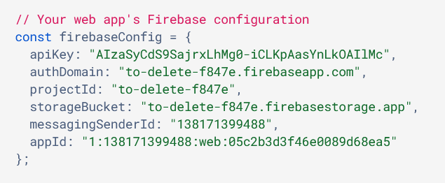

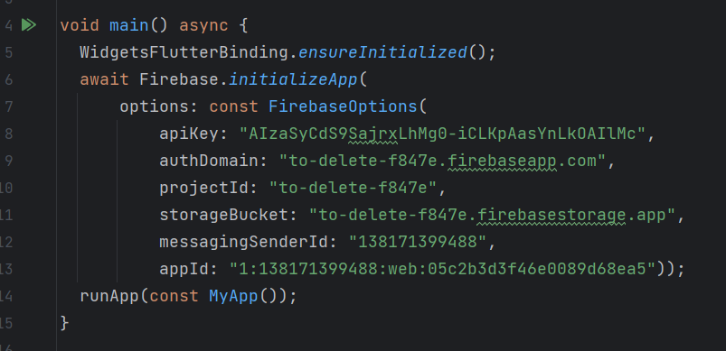
Firebase Setup
Access https://console.firebase.google.com/
Create a project
Add an app to your project
Copy API keys
Access project’s Firestore database
Create database
Modify security rules to allow requests
Install “cloud_firestore” and “firebase_core” to your Flutter app
https://pub.dev/packages/cloud_firestore
https://pub.dev/packages/firebase_core
Initialize Firebase app within your Flutter code
Make “main” function async
Call “WidgetFlutterBinding.ensureInitialized”
Initialize Firebase app before executing Flutter app

Slide 6
Firebase Structure
Data in Firebase is comprised of either documents or collections
Documents are the base unit of data in Firebase
They are like a JSON file where each document has fields in a key-value arrangement
Collections are an aggregation of related documents in Firebase
They can be seen as a list of individual documents
A document is allowed to have collections inside of it, which in turn can have documents inside of those collections
Nesting documents and collections

Slide 7


Basic Firebase Requests
Most of your Firebase operations will involve either reading or writing data to your Firestore database
Once you have set up Firebase, access your Firestore client via “FirebaseFirestore.instance”
You can access a collection via the instance’s “collection” method
You can obtain a document reference via a collection’s “doc” method
It will create a new reference if no document id is provided
You can read the document’s current state from the reference with the “get” method
Operation must be awaited as this is when communication with Firebase is first accomplished
You can get the JSON data from the document with the “data” method
The data may be null for various reasons so make sure to perform null checking when needed
Return the value “0” if data is null
You can modify a document’s data via either the “set” or “update” methods
Set will completely replace the document’s data while update will only set the provided fields

Slide 8
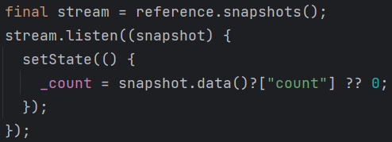
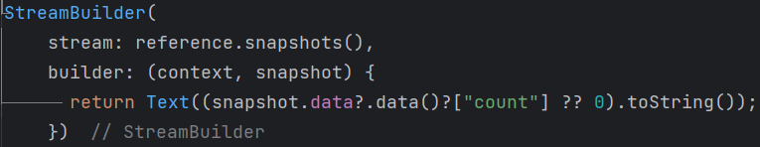
Using Real-time Data
Firebase allows devices to listen to changes within a select document or collection
Oftentimes it is better to read data real-time instead of manually reading it on command
Access a document or collection’s “snapshots” to receive a stream of live data updates that can be listened to
The callback provided to the stream’s “listen” method will be called every time the specified document or collection has been updated
Automatically update application state with StreamBuilder widget

Slide 9
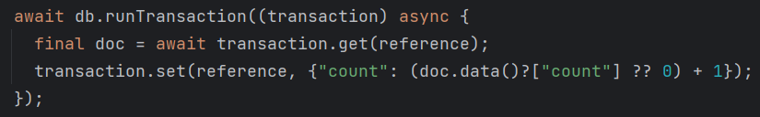
Handling Conflicting Requests
When your application has many users trying to edit data at the same time, those requests will conflict with each other
Transactions
They are a way to ensure that a document can only be modified by one request at a time, handling each request to the document like a queue
FieldValue operations
They are a set of provided operations that tell the Firebase server what to do in certain cases
FieldValue.increment – Increment the specified field by the specified value
FieldValue.delete – Remove the specified field from the document
FieldValue.arrayUnion – Add an element to the specified field if it is a list
FieldValue.arrayRemove – Remove an element from the specified field if it is a list
FieldValue.serverTimestamp – Assign to the specified field the request’s timestamp

